Slide 1

INTRO TO CIRCUITS + ELECTRICITY!!
day one
Notes:
Max & maya

Slide 2
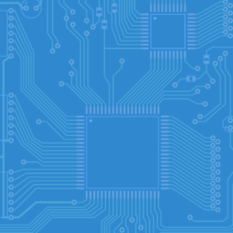
Day 1
01
02
03
What + Why?
Build
Share
30 mins - What’s a circuit? How do we use them?
30 mins - Build your own buzzer or LED circuit :)
Share what you’ve created!
Notes:
maya

Slide 3

A quick check-in to get to know all of y’all!
WHAT’S YOUR NAME?
YOUR LEAST FAVORITE CANDY FLAVOR
or
THE BEST PIZZA TOPPINGS
TYPE IN CHAT:
Then choose one of the below or both if you’d like!
Notes:
max

Slide 4
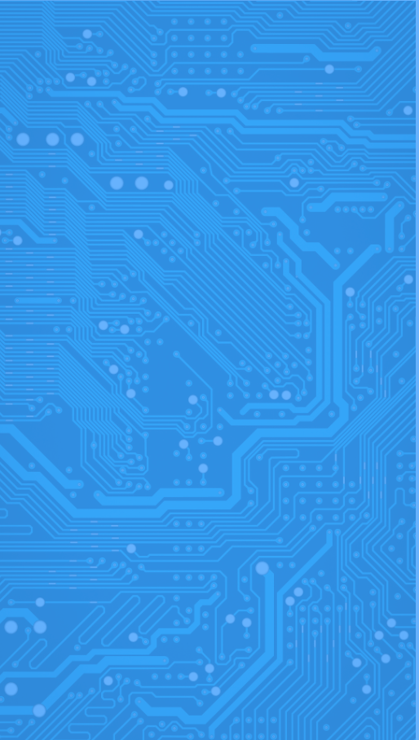
01
What + Why
What’s a circuit? What’s electricity? How do we use it?
Notes:
max

Slide 5
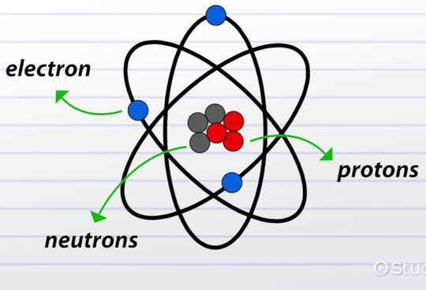
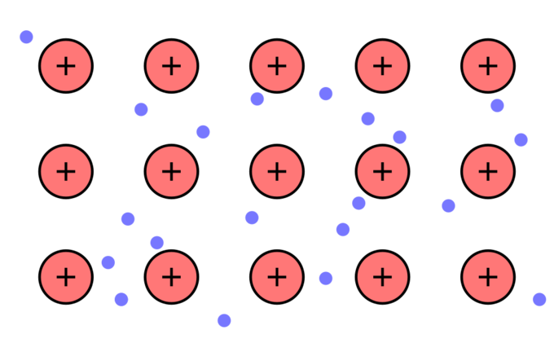
WHAT IS ELECTRICITY?
All matter is made of atoms, which go down into protons, neutrons, and electrons.
In metals: the electrons stop sticking strictly to their atoms and are “shared”
The movement of the electrons creates the electricity
Electrons in a metal:
Notes:
maya

Slide 6
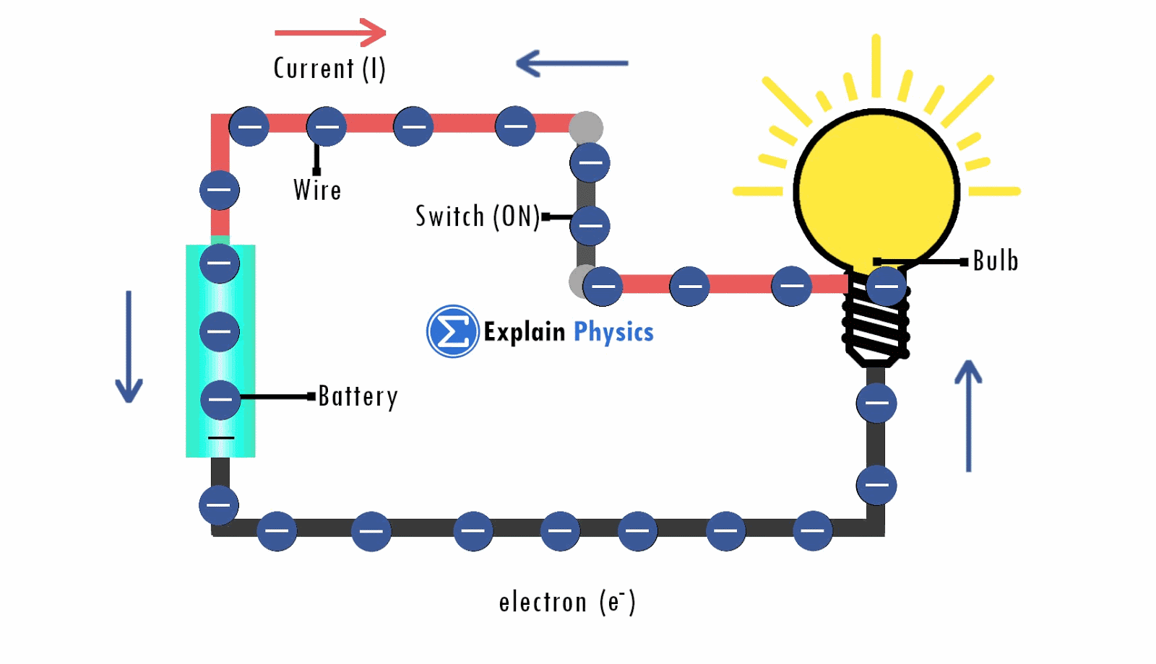
Electricity: flow of electrons
Notes:
max

Slide 7
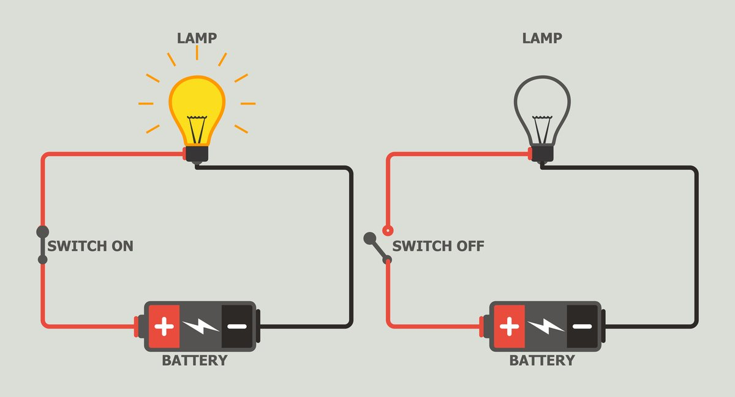
CIRCUITS
circuit:an unbroken loop of conductive material that allows charge carriers to flow through continuously without beginning or end.
Closed
Open
Notes:
maya

Slide 8
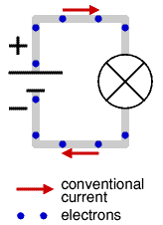
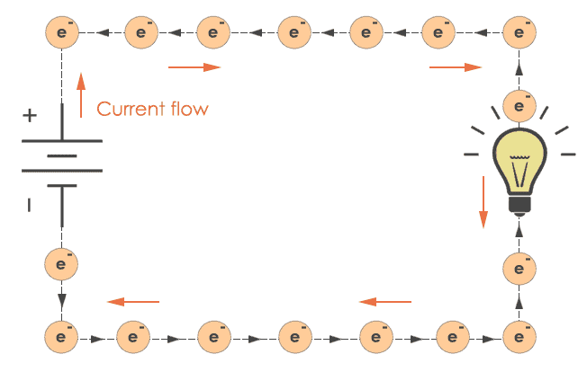
CIRCUITS
In a circuit electrons flow from - to + or negative to positive
The negative side of the power source is called ground
And supplies 0 volts
Whereas the positive side of the power source powers however many volts it is rated for
A 9 volt battery would power 9 volts
Notes:
max

Slide 9
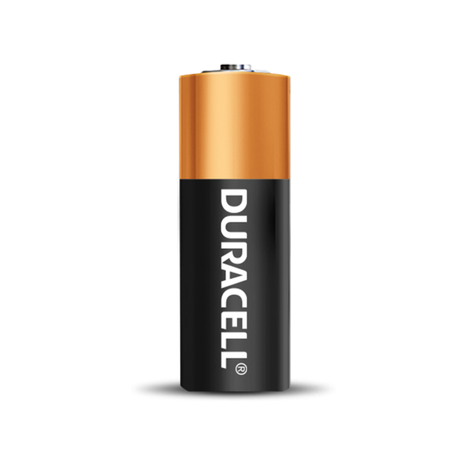
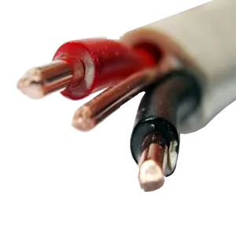
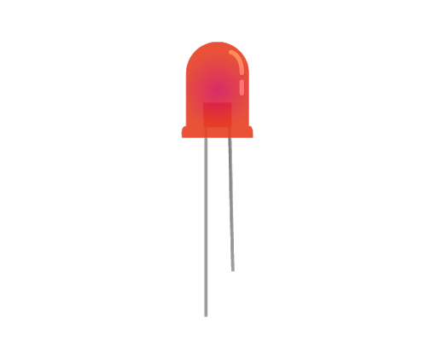
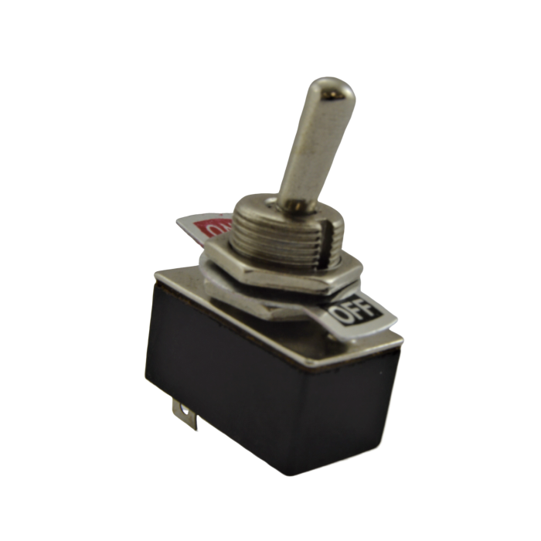
BASIC COMPONENTS OF A CIRCUIT
Power Source
Conductor
01
02
A battery or wall outlet (we’ll be using a battery)
The wires that carry the current
Load
Switch
What will be powered (LED, buzzer, etc)
04
03
Connects the circuit so electricity can flow
Notes:
maya

Slide 10
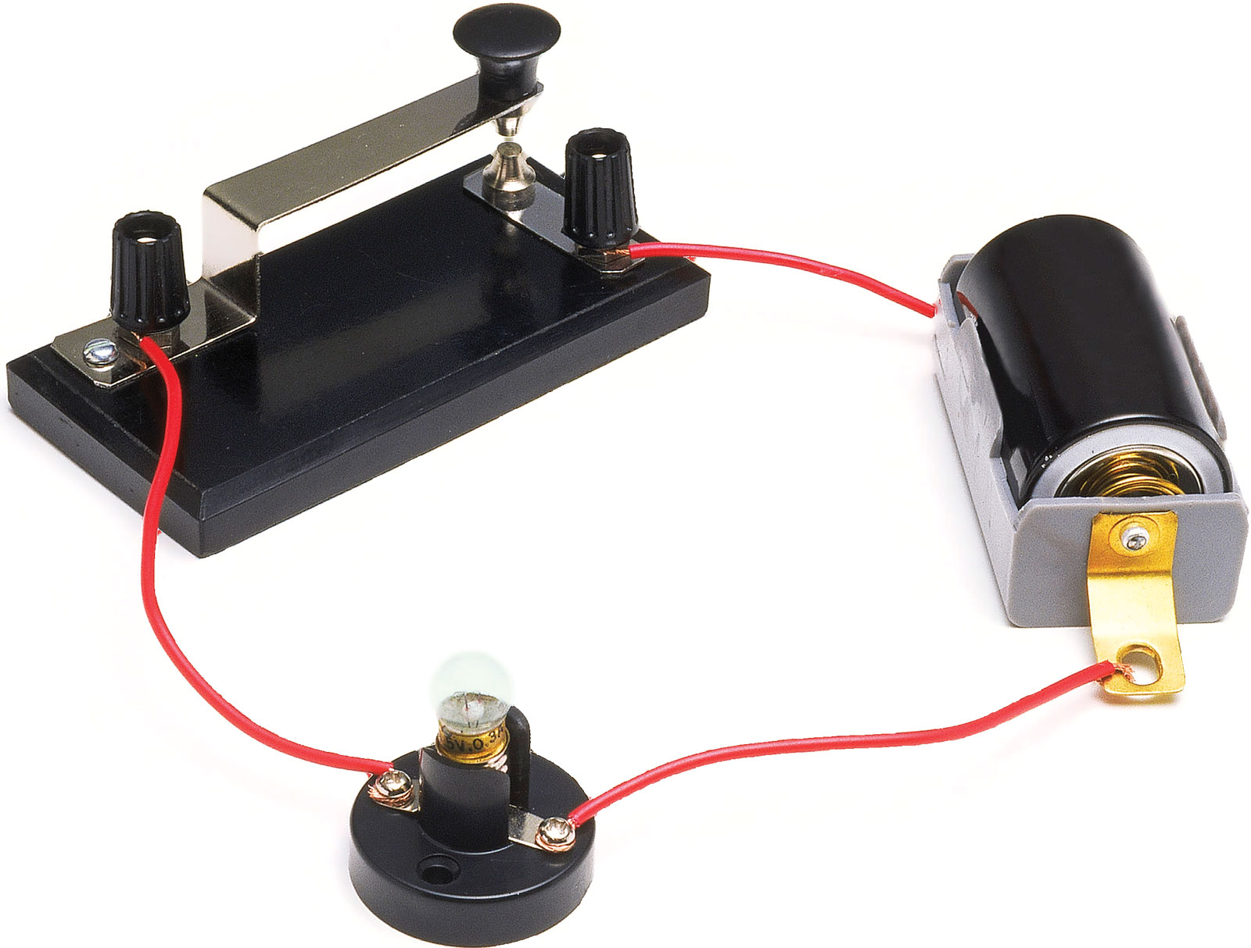
BASIC COMPONENTS OF A CIRCUIT
Power Source (battery)
Switch
Load (lightbulb)
Conductor (wire)
Notes:
max

Slide 11
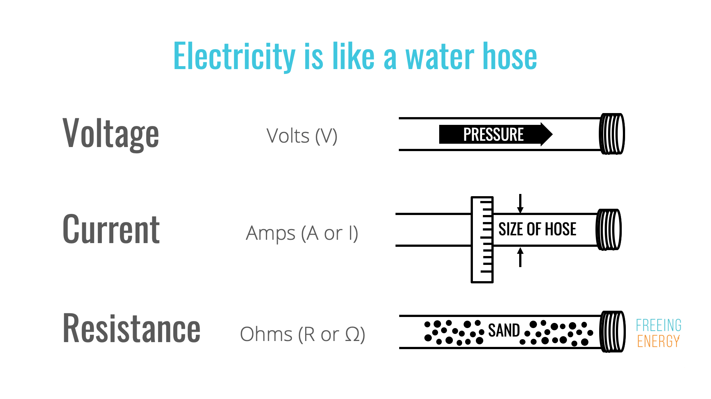
Notes:
maya

Slide 12
BASIC COMPONENTS OF A CIRCUIT
Voltage Source
Switch
Resistance
Conductor -- carries current
Notes:
max

Slide 13
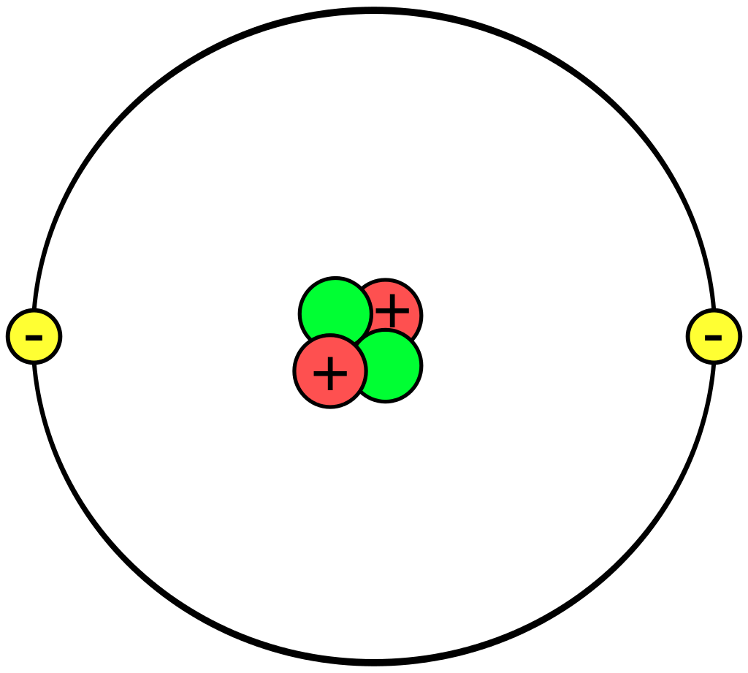
Current is the flow of ___
Protons
Neutrons
Electrons
Bonus: label this atom with the answer choices
Notes:
maya

Slide 14
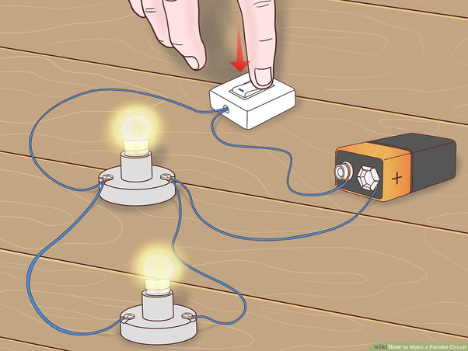
Is this an open or closed circuit?
Notes:
max

Slide 15
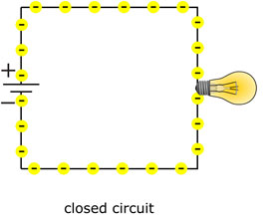
What do a,b,c represent?
Use the vocabulary terms: resistance, voltage source, current
B
A
C
Notes:
maya

Slide 16
02
BUILD
Let’s make our own circuit!!
Notes:
max

Slide 17
WHAT YOU’LL NEED
JUST YOUR SNAP CIRCUIT KIT :D
Notes:
max

Slide 18
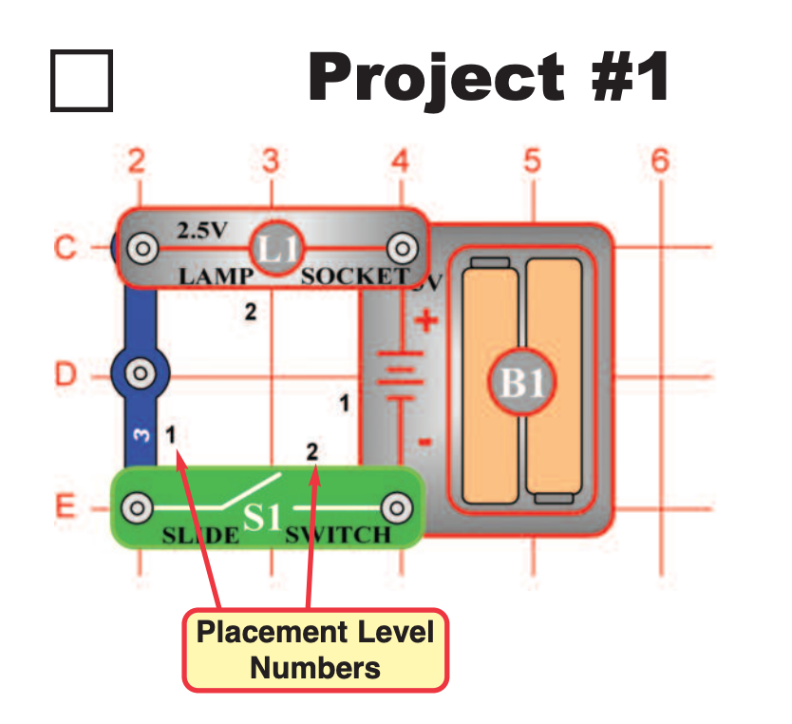
CIRCUIT #1
Simple circuit
Notes:
maya

Slide 19
WHAT DOES EACH PIECE DO?
Battery
L1 lamp
Slide switch
Blue wire piece
POWER SOURCE
LOAD/RESISTANCE
SWITCH
CONDUCTOR
Parts of a Circuit Reminder:
Switch
Conductor
Load
Power source
Notes:
max

Slide 20
INSTRUCTIONS
1.
2.
Place down the battery piece. (you can follow the exact places on the visual)
Snap in a 3 unit long piece with one space in between
3.
4.
Connect one end of the wire piece to the negative end of the battery with the slide switch
Connect the final circuit with the L1 light
Notes:
maya

Slide 21

Flip the switch. Your light should turn on!
Notes:
maya

Slide 22
NOT WORKING? HERE ARE SOME TIPS:
BATTERY
LOOSE CONNECTION
POLARITY
It’s loose or dead. Put it in securely or replace it. Also make sure the positive and negatives are where they should be
Make sure the pieces are snapped in place very securely
Check the polarity of everything :D
Notes:
maya

Slide 23
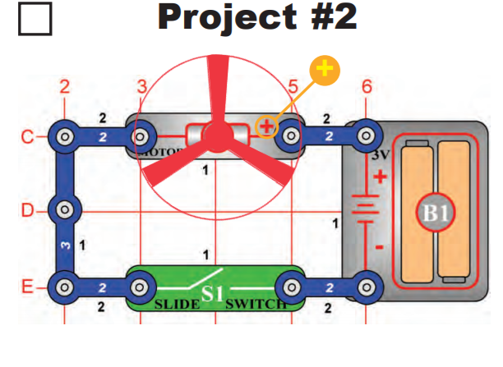
CIRCUIT #2
Changing electrical energy to mechanical

Slide 24
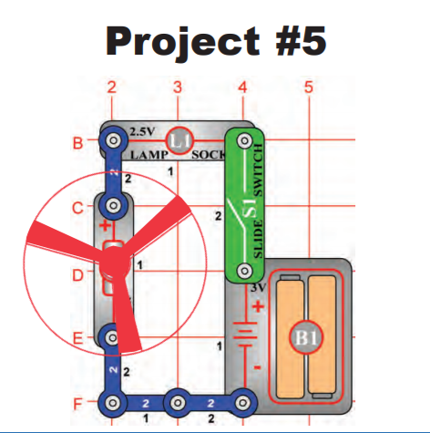
CIRCUIT #5
Motor + light in series
The light protects the motor from getting all the voltage

Slide 25
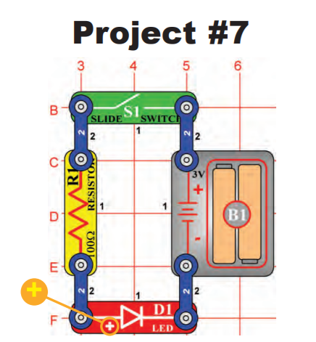
CIRCUIT #7
one-way components (polarized)

Slide 26
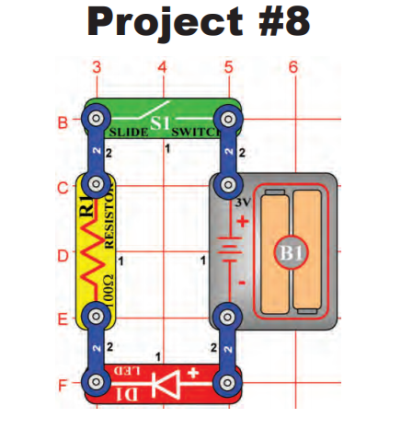
CIRCUIT #8
Trying the LED backwards

Slide 27
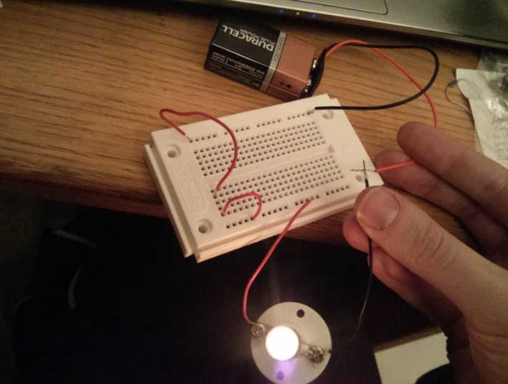
Notes:
max

Slide 28

Ok, this is cool and all but why do we need this info to build a plane?
Notes:
max

Slide 29
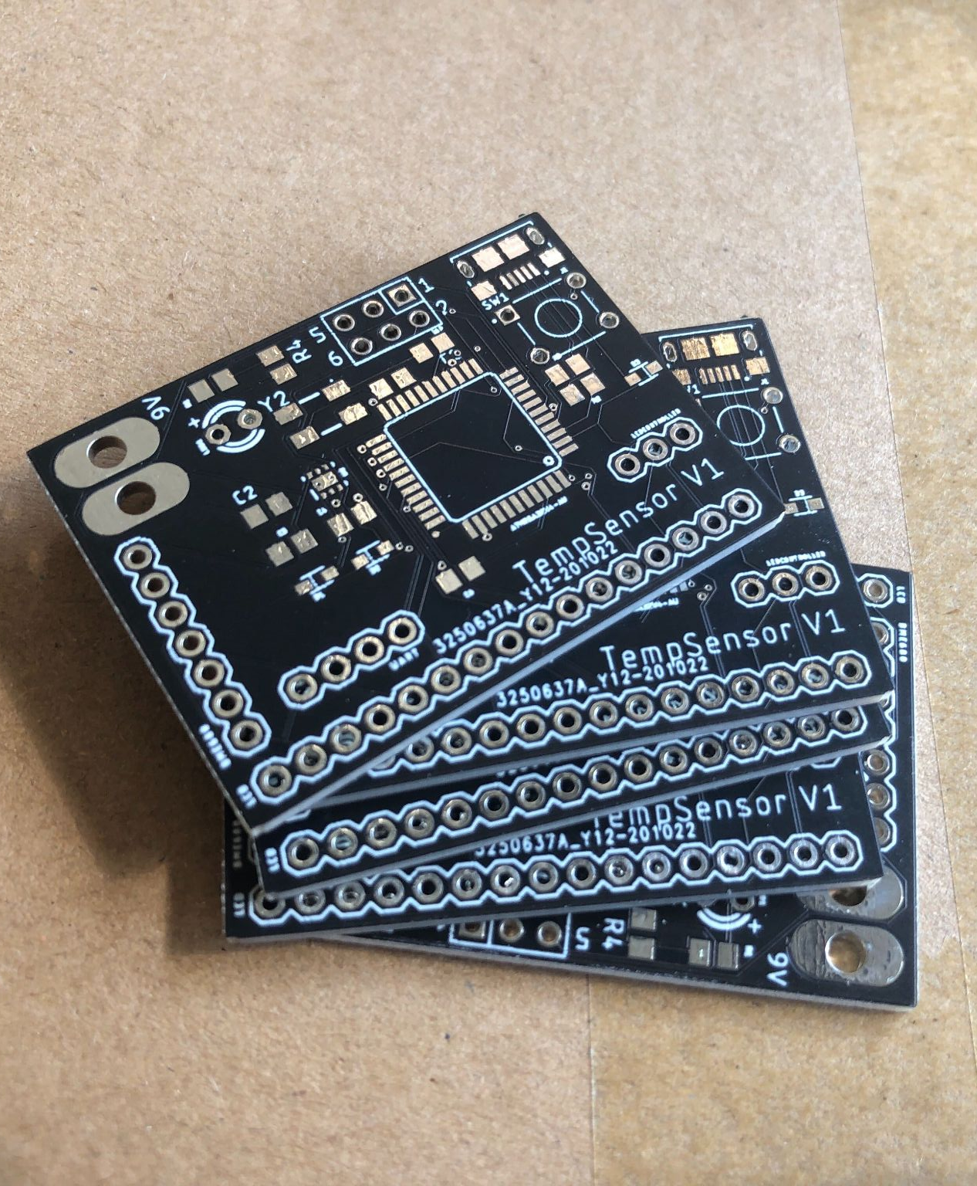
Mini Computers!
We use these circuits take in sensor information (how fast are we going?) and tell it to the pilot
Notes:
max

Slide 30
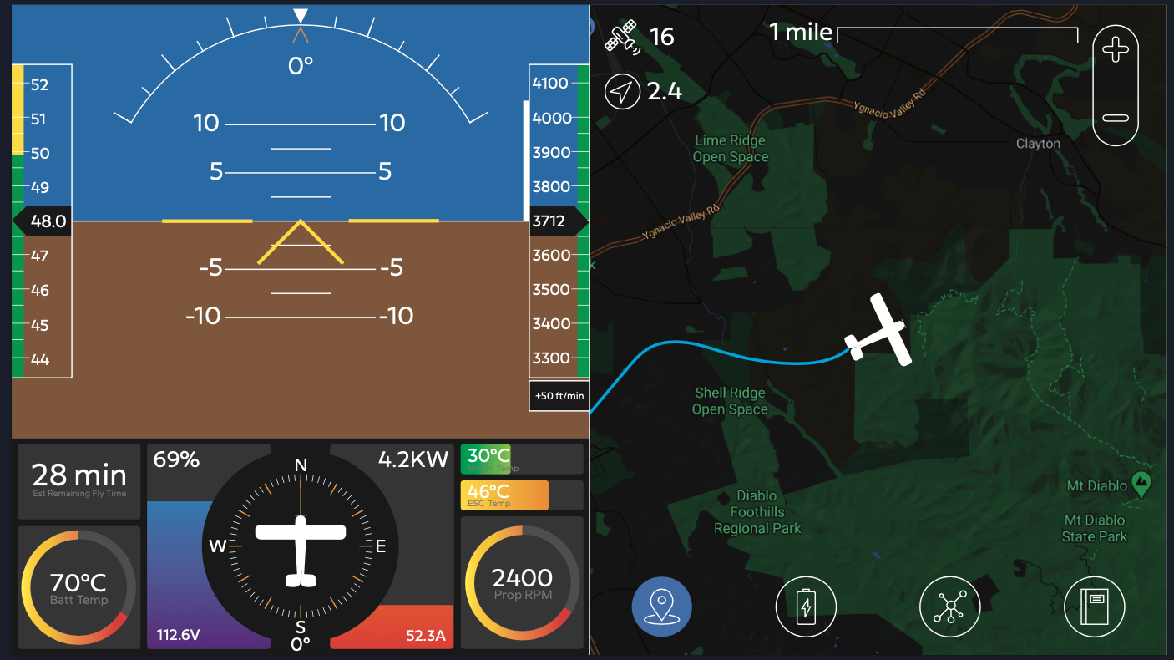
Notes:
max

Slide 31
THANK YOU!
Feedback Form: https://forms.gle/7FUv6SNSV12fmz2T9
Notes:
maya

